Slide 1
SEASONAL AGRICULTURE PERFORMANCE ANALYSIS
Major Project Report
VOIS AICTE Batch1 2026–2027
Student Name: Aman Puri
College Name: ____________________
AICTE STU ID: ____________________
Seasonal Agriculture Performance Analysis • Slide 1

Slide 2
PROBLEM STATEMENT
PROJECT
Agricultural performance varies across Kharif, Rabi and Zaid seasons.
Farmers and decision-makers need to understand how season affects yield, resource use and profitability.
The project analyzes farm-level data to identify seasonal patterns and support evidence-based agricultural planning.
Seasonal Agriculture Performance Analysis • Slide 2

Slide 3
PROJECT DESCRIPTION
PROJECT
Dataset contains 4,000 farm records and 28 analytical variables.
Covers 3 seasons: Kharif, Rabi and Zaid; 8 crops; 8 states and 10 districts.
Analysis includes data cleaning, descriptive statistics, season/crop comparisons, irrigation analysis, correlation analysis and statistical testing.
Key outcomes studied: yield, production, cost, revenue, profit, water usage and water efficiency.
Seasonal Agriculture Performance Analysis • Slide 3

Slide 4
WHO ARE THE END USERS?
PROJECT
Farmers — compare seasonal profitability and resource requirements.
Agricultural planners — identify underperforming seasons and prioritize interventions.
Agribusiness stakeholders — evaluate crop and season profitability.
Data analysts / decision-makers — use seasonal evidence for planning and benchmarking.
Seasonal Agriculture Performance Analysis • Slide 4

Slide 5
TECHNOLOGY USED
TOOLS
Python
Pandas — data loading, cleaning, grouping and summary statistics
NumPy — numerical operations
Matplotlib & Seaborn — charts and visualization
Jupyter Notebook — analysis workflow
Power BI — proposed future dashboard for interactive reporting
Seasonal Agriculture Performance Analysis • Slide 5

Slide 6
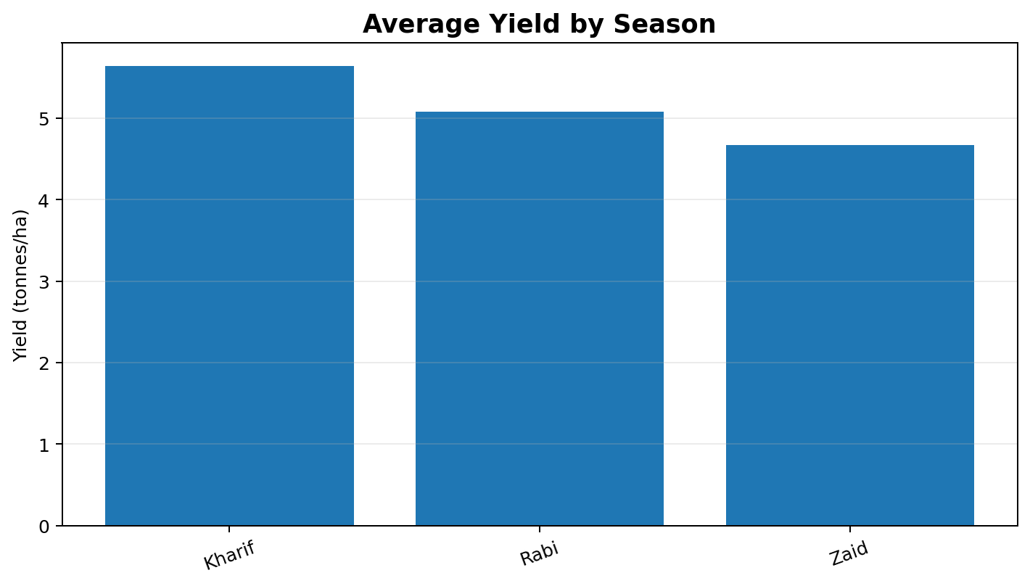
SEASON-WISE PERFORMANCE
RESULTS
Kharif: average yield 5.64 T/Ha; average profit ₹1.79 lakh.
Rabi: average yield 5.08 T/Ha; average profit ₹0.88 lakh.
Zaid: average yield 4.67 T/Ha; average profit –₹0.25 lakh.
Kharif shows the strongest average economic performance; Zaid has negative average profit.
Seasonal Agriculture Performance Analysis • Slide 6

Slide 7
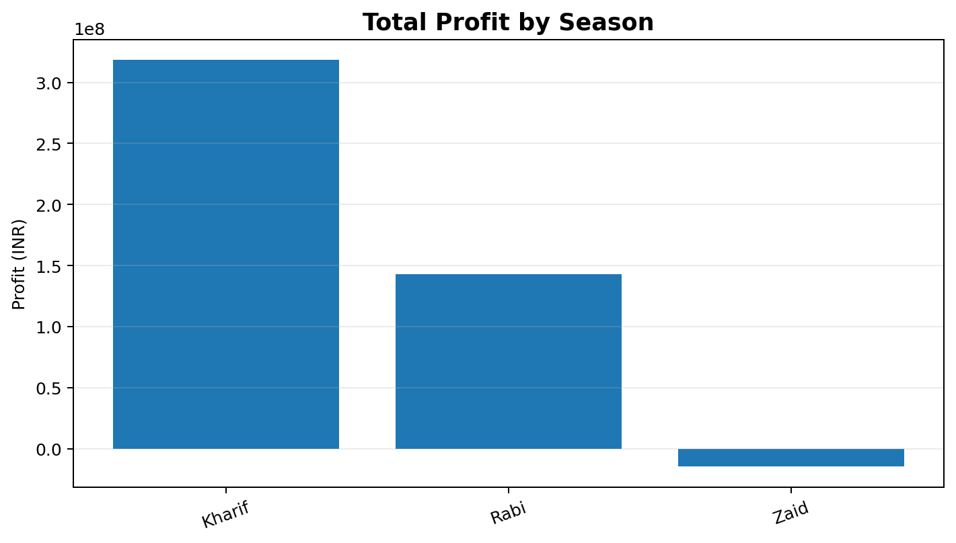
TOTAL PROFIT BY SEASON
RESULTS
Kharif total profit: ₹31.83 crore.
Rabi total profit: ₹14.27 crore.
Zaid total profit: –₹1.47 crore.
The seasonal difference is strongest in economic performance.
Seasonal Agriculture Performance Analysis • Slide 7

Slide 8
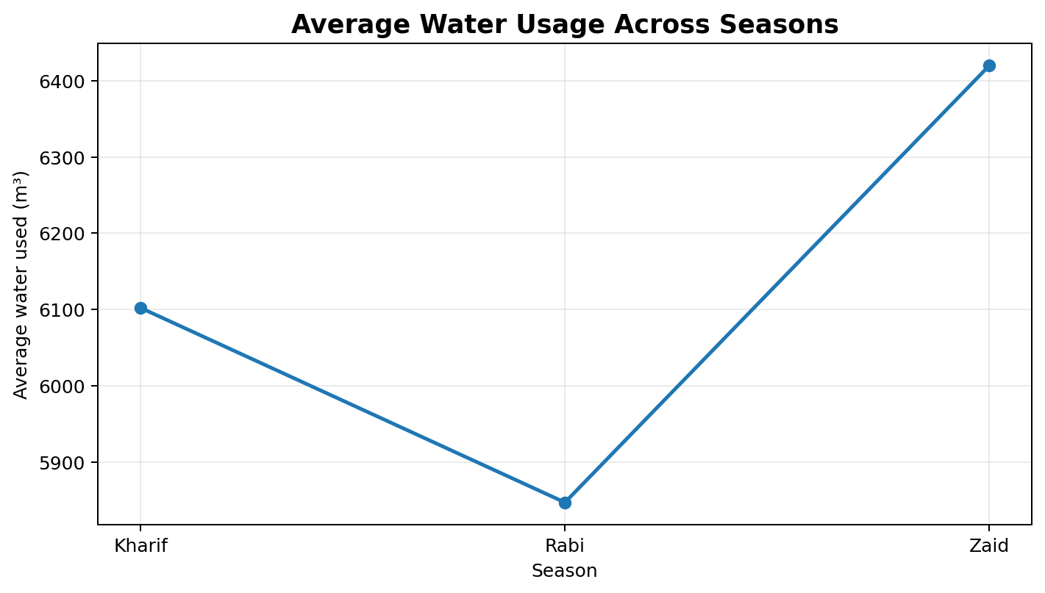
RESOURCE USE & WATER EFFICIENCY
RESULTS
Kharif average water use: 6,102 m³.
Rabi average water use: 5,847 m³.
Zaid average water use: 6,420 m³.
Zaid uses the most water, while its average water efficiency is the lowest among seasons.
Seasonal Agriculture Performance Analysis • Slide 8

Slide 9
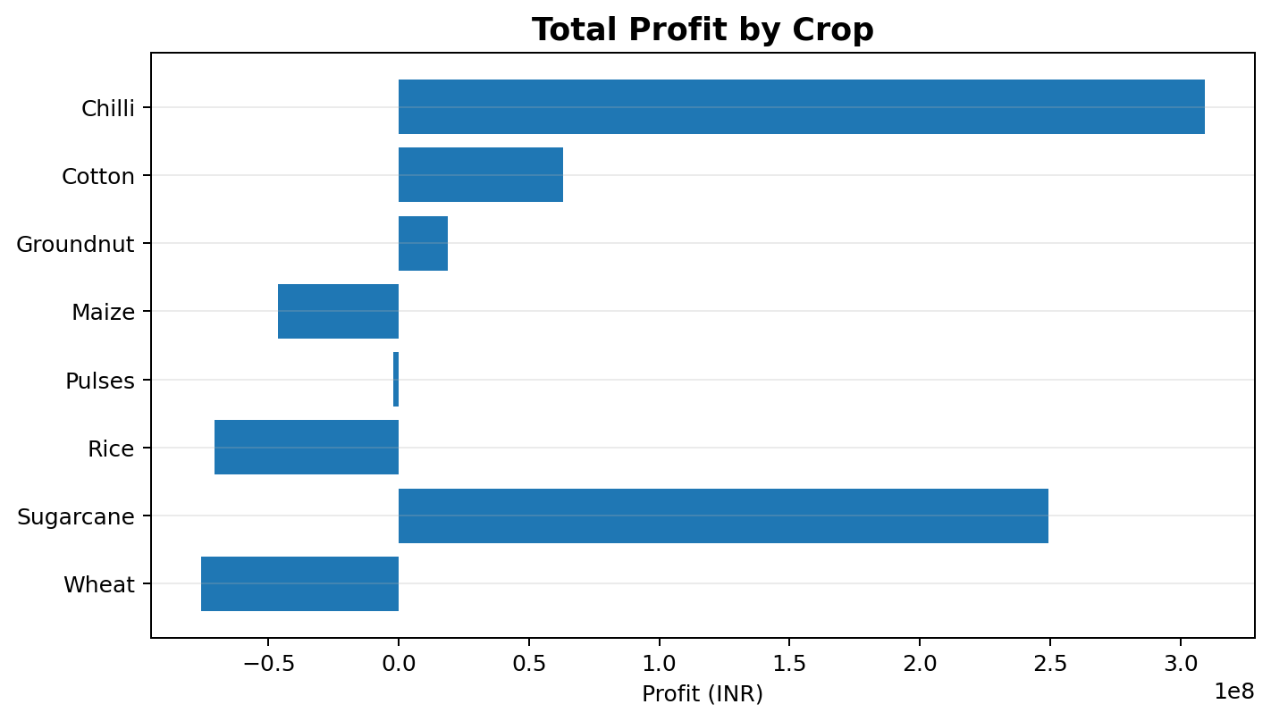
CROP PROFITABILITY
RESULTS
Chilli has the highest total profit: ₹30.94 crore.
Sugarcane is second: ₹24.92 crore.
Wheat and Rice show the largest total losses among the crops.
Crop-level profitability varies substantially, so season and crop should be considered together.
Seasonal Agriculture Performance Analysis • Slide 9

Slide 10
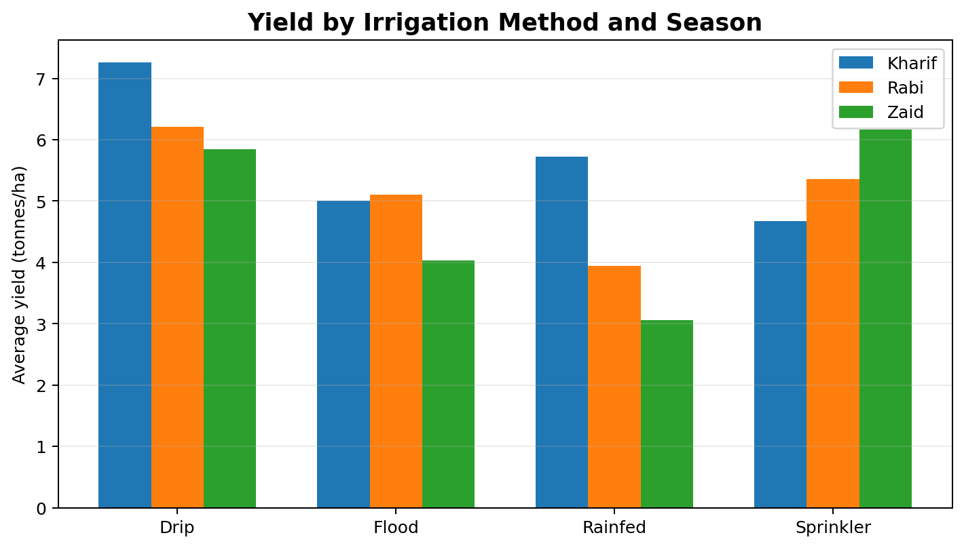
IRRIGATION & YIELD
RESULTS
Drip has the highest average yield in Kharif: 7.26 T/Ha.
Sprinkler has the highest average yield in Zaid: 6.17 T/Ha.
Rainfed yield is lower in Rabi and Zaid than in Kharif.
Irrigation performance varies by season, so one method is not uniformly best across all seasons.
Seasonal Agriculture Performance Analysis • Slide 10

Slide 11
CORRELATION ANALYSIS
Farm Area ↔ Total Cost: 0.962 — very strong positive association.
Yield ↔ Water Efficiency: 0.915 — very strong positive association.
Revenue ↔ Profit: 0.887 — strong positive association.
Yield ↔ Production: 0.885 — strong positive association.
Correlation indicates association, not causation.
Seasonal Agriculture Performance Analysis • Slide 11

Slide 12
STATISTICAL TESTING — ONE-WAY ANOVA
RESULTS
Metric | F-statistic | p-value | Conclusion
Profit | F = 34.29 | p < 0.001 | Significant
Water Efficiency | F = 6.95 | p = 0.001 | Significant
Yield | F = 1.54 | p = 0.214 | Not significant at 5%
Profit and water efficiency show statistically significant seasonal differences.
Yield is not statistically significant at the 5% level.
This supports focusing seasonal interventions on profitability and water-efficiency differences.
Seasonal Agriculture Performance Analysis • Slide 12

Slide 13
CONCLUSION & RECOMMENDATIONS
RESULTS
Kharif performs best overall on average economic outcomes, while Zaid records negative average profit.
Zaid also has the highest average water use and lower water efficiency.
Prioritize profitable crop-season combinations such as Chilli and Sugarcane based on observed results.
Improve water planning and resource efficiency during Zaid.
Use seasonal environmental, resource and profitability indicators together for evidence-based planning.
Seasonal Agriculture Performance Analysis • Slide 13

Slide 14
FUTURE SCOPE
FUTURE
Build an interactive Power BI dashboard with Season, State, District and Crop filters.
Add crop-level and state-level profitability benchmarking.
Develop predictive models for yield and profit forecasting.
Integrate weather forecasts and market-price data for real-time planning.
Create water-efficiency recommendations for resource-intensive crop-season combinations.
Extend the analysis with multi-year data to study long-term trends.
Seasonal Agriculture Performance Analysis • Slide 14

Slide 15
GITHUB LINK
SUBMISSION
GitHub Repository
GitHub link: ______________________________
Add the final Jupyter Notebook and project files to the repository before submission.
Seasonal Agriculture Performance Analysis • Slide 15

Slide 16
VOIS COURSE COMPLETION CERTIFICATE
SUBMISSION
Course name: Data Visualization
Insert your VOIS course completion certificate screenshot here.
Seasonal Agriculture Performance Analysis • Slide 16

Slide 17
THANK YOU
Seasonal Agriculture Performance Analysis
Seasonal Agriculture Performance Analysis • Slide 17

